Slide 1

Module - 07 Neural Network and Deep Learning
By, Tahir Mirji

Slide 2
Contents
Introduction to deep learning
Major Trends in deep learning
How deep learning is applied to supervised learning
Categories of models CNN
RNN & when they should be applied
when does deep learning will work well.
Deep learning Continued
Build a logistic regression model
structured as shallow neural network
Implement ML Algorithm, making predictions
Derivative computation & gradient descent
implement computationally efficient and highly vectored version of models
compute derivatives for logistic regression using back propagation mindset
familiarize Numpy
Logistic regression as a Neural Network
python and vectorization

Slide 3
Contents
Introduction to shallow Neural Networks
Hidden unites and hidden layers
apply various activation function
Build first forward and backward propagation with a hidden layer
apply random initialization to NN
build and train a neural network with one hidden layer
Introduction to Deep Neural Networks
Build and train deep L-Layer NN
Analyze matrix and vector dimensions to check NN implement.
How to use cache to pass info from forward prop to back-propagation
role of hyper parameters in deep learning.

Slide 4



Slide 5
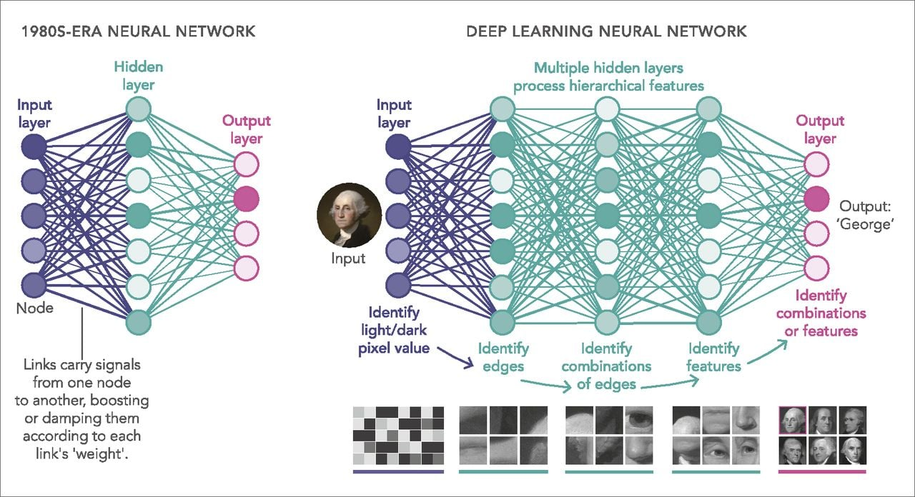
What's deep learning
Deep learning is a branch of machine learning which is completely based on artificial neural networks, as neural network is going to mimic the human brain so deep learning is also a kind of mimic of human brain.
https://playground.tensorflow.org/

Slide 6
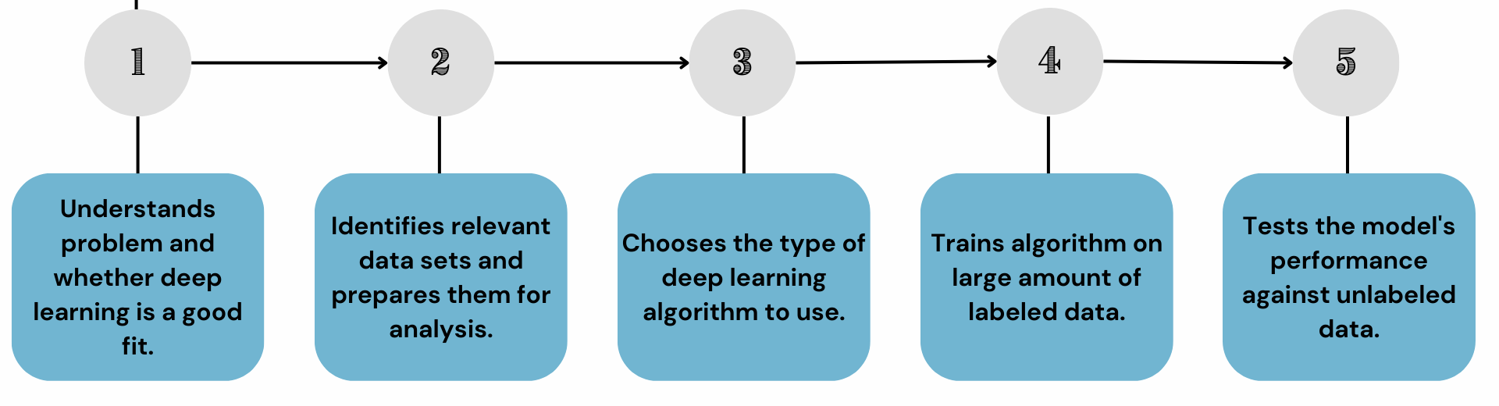
Introduction To Deep Learning
Deep Learning models are able to automatically learn features from the data.
Requires the larger volume of dataset compared to machine learning.
Better for complex task like image processing, natural language processing, etc.
Takes more time to train the model Relevant features are automatically extracted from images.
It is an end-to-end learning process.
It is more complex, it works like the black box interpretations of the result are not easy.

Slide 7
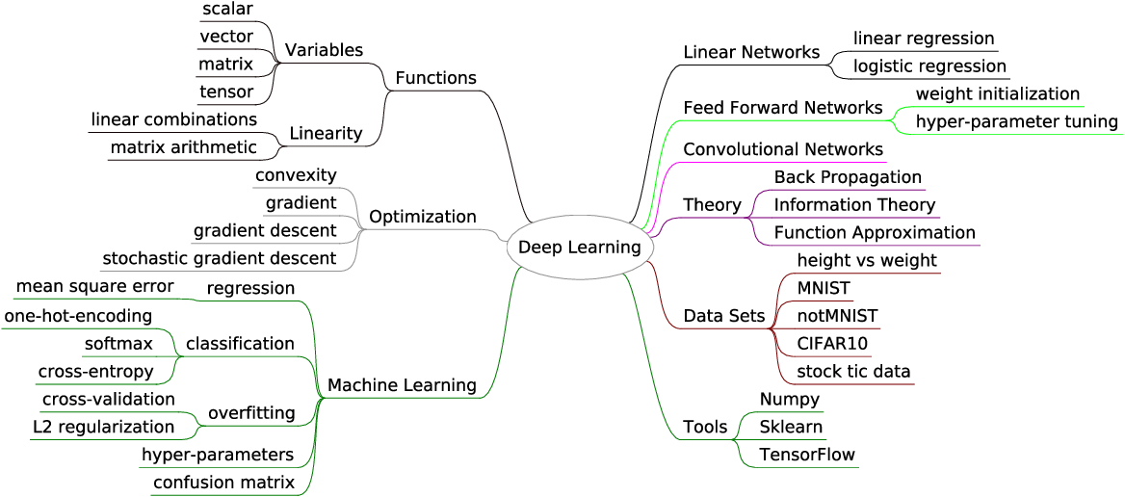
Introduction To Deep Learning

Slide 8
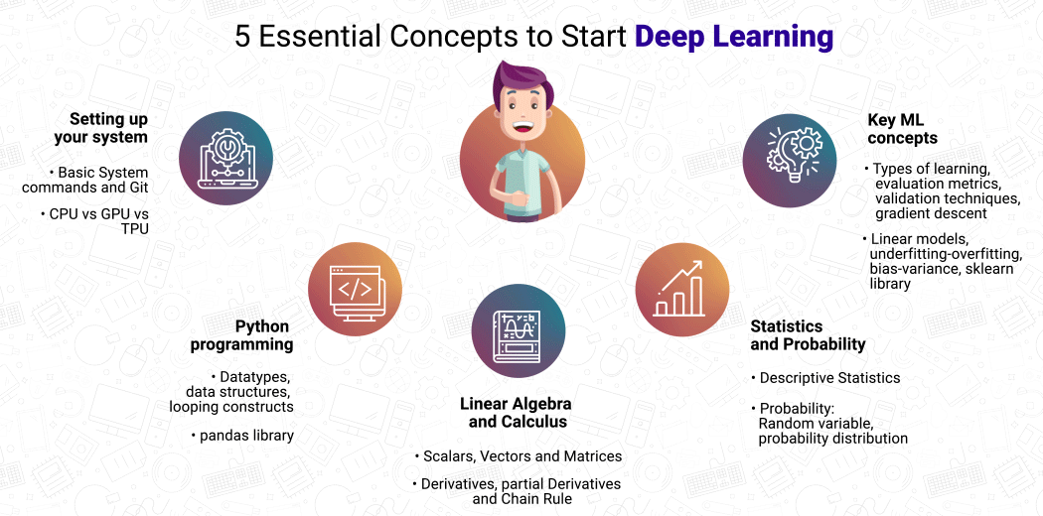

Slide 9
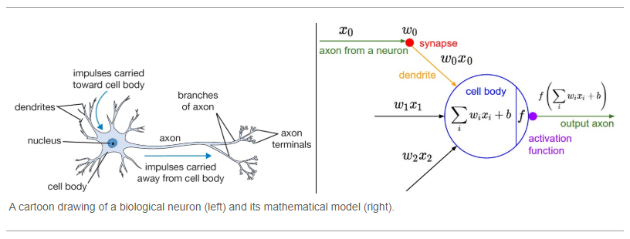
Neural Network Concept

Slide 10
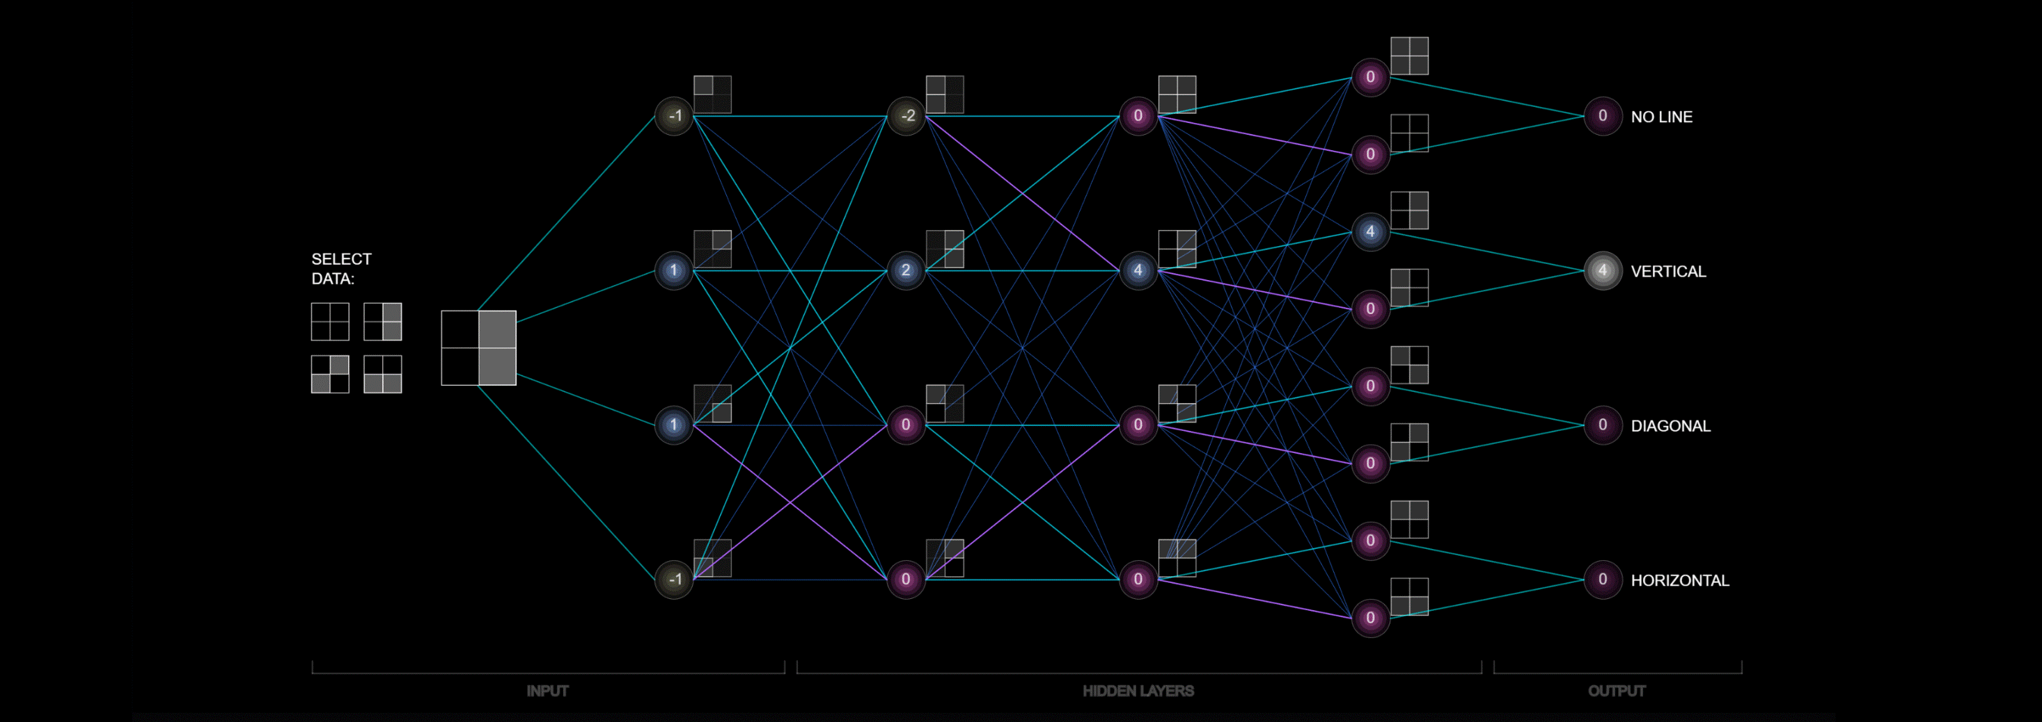
Architectures
In human brain approximately 100 billion neurons all together this is a picture of an individual neuron and each neuron is connected through thousand of their neighbors.
The question here is how do we recreate these neurons in a computer. So, we create an artificial structure called an artificial neural net where we have nodes or neurons.
We have some neurons for input value and some for output value and in between, there may be lots of neurons interconnected in the hidden layer.

Slide 11
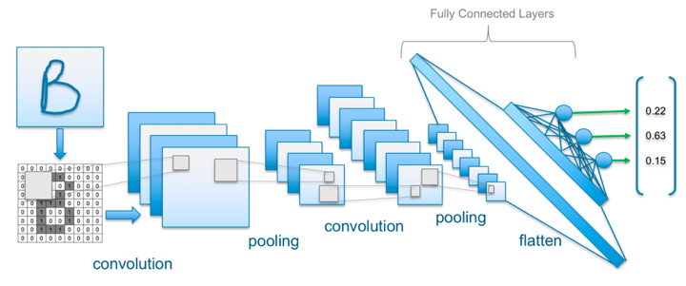

Architectures

Slide 12
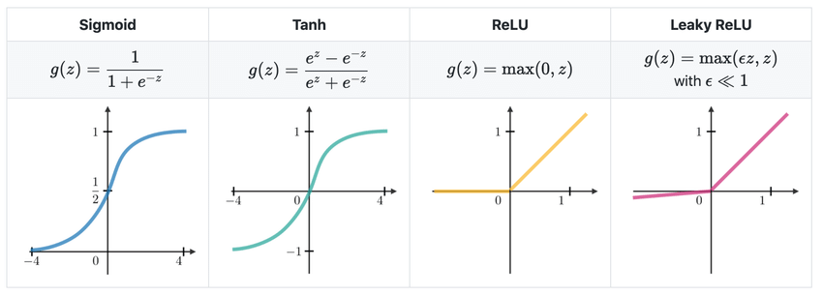
Activation Functions
In Neural Network the activation function defines if given node should be “activated” or not based on the weighted sum.
Let’s define this weighted sum value as z.
why “Step Function” and “Linear Function” won’t work and “Sigmoid Function” is one of the most popular activation functions.
Below are 4 popular activation functions.

Slide 13
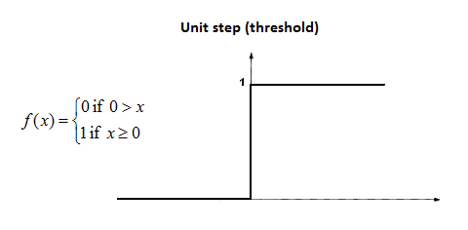
Step Function
One of the first ideas would be to use so called “Step Function” (discrete output values) where we define threshold value and:
if(z > threshold) — “activate” the node (value 1) if(z < threshold) — don’t “activate” the node (value 0)
But it has drawback since the node can only have value 1 or 0 as output.
In case when we would want to map multiple output classes (nodes) we got a problem.
The problem is that it is possible multiple output classes/nodes to be activated (to have the value 1).
So we are not able to properly classify/decide.

Slide 14
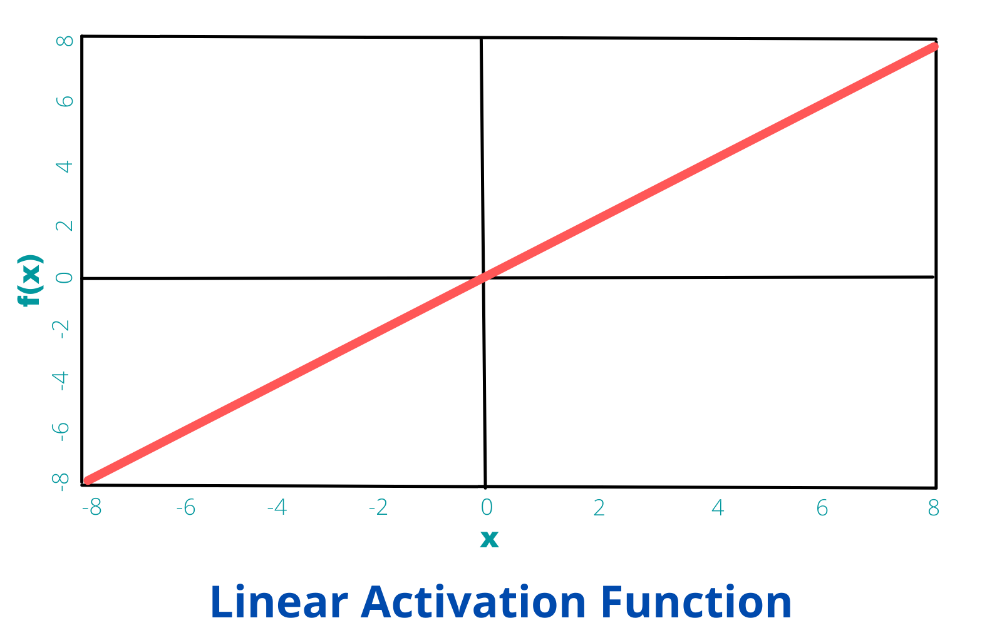
Linear Function
Another possibility would be to define “Linear Function” and get a range of output values.
However using only linear function in the Neural Network would cause the output layer to be linear function, so we are not able to map any non-linear data. The proof for this is given by:
then by function composition we get
which is also a linear function.

Slide 15
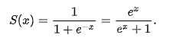
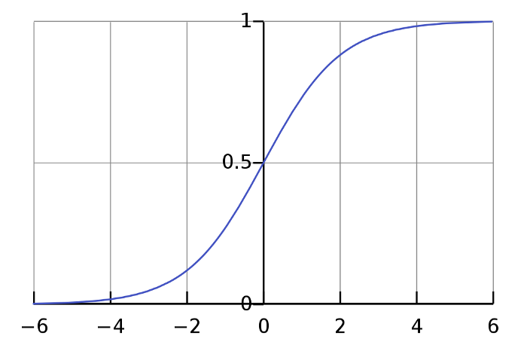
Sigmoid Function
It is one of the most widely used activation function today. It equation is given with the formula below.
It has multiple properties which makes it so popular:
It’s non-linear function
Range values are between (0,1)
Between (-2,2) on x-axis the function is very steep, that cause function to tend to classify values ether 1 or 0
Because of this properties it allows the nodes to take any values between 0 and 1.
In the end, in case of multiple output classes, this would result with different probabilities of “activation” for each output class.
And we will choose the one with the highest “activation”(probability) value.

Slide 16
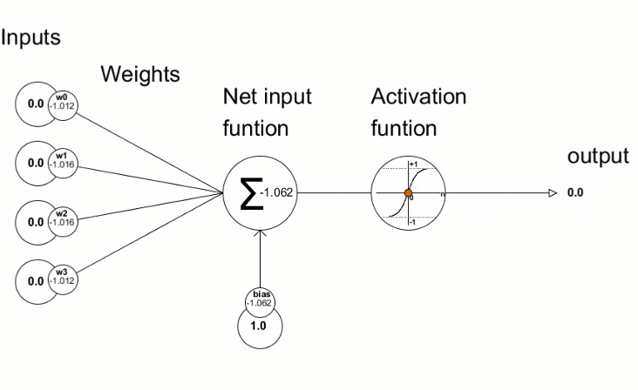
Bias Node
Using “bias” node is usually critical for creating successful learning model.
A bias value allows to shift the activation function to the left or right and it helps getting better fit for the data (better prediction function as output).

Slide 17
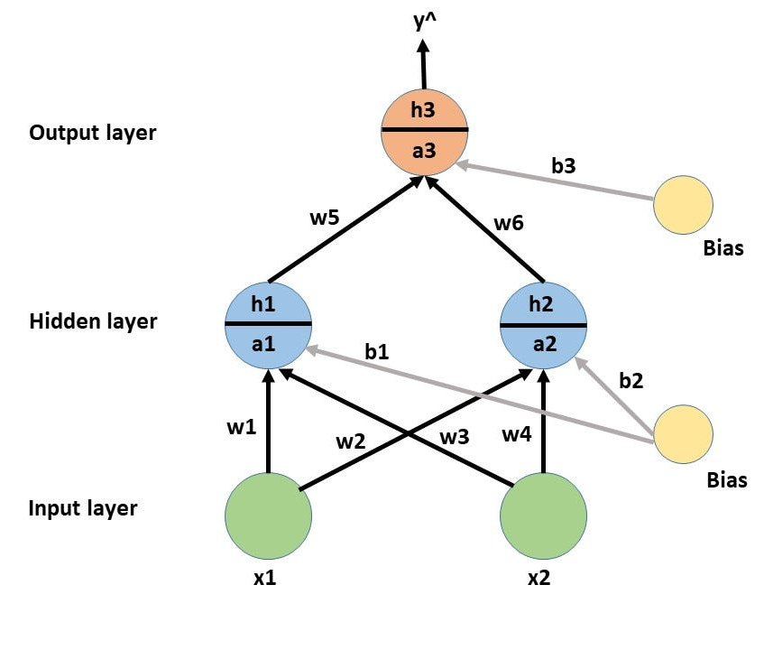
Forward Propagation Calculation
This process of Forward propagation is actually getting the Neural Network output value based on a given input.
This algorithm is used to calculate the cost value.
What it does is the same mathematical process as the one described in section 2 “Model Representation Mathematics”.
Where in the end we get our hypothesis value

Slide 18
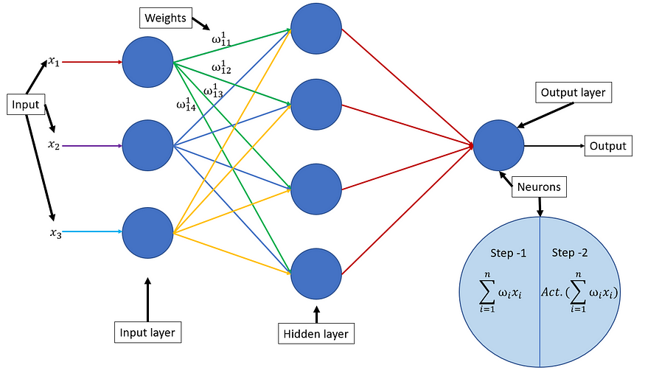

Slide 19
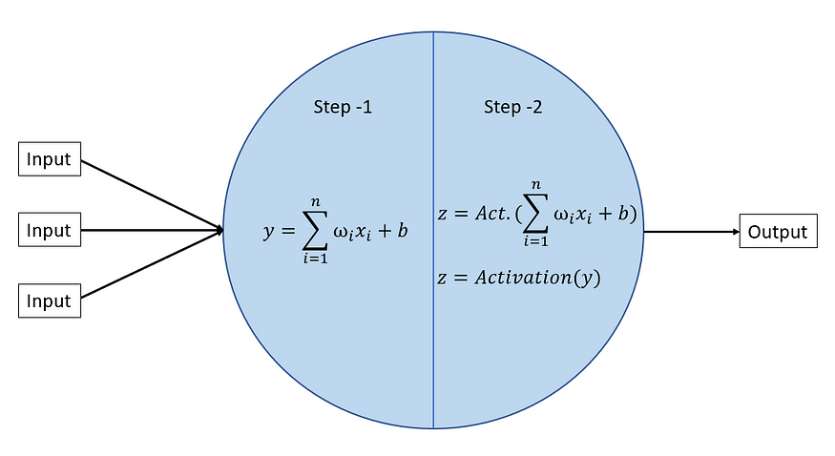
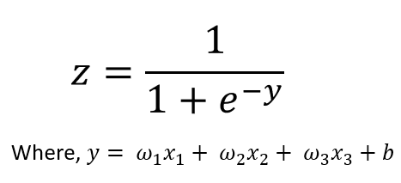
Step -1, y = Summation of the product of weight and input then the addition of bias to the product of weight and input.
step -2, the value y is fed to the Activation function Which gives the output value(z) of the neuron.
Similarly, the Information/output value(z) is fed to the next layer neurons as input, Till the output layer.

Slide 20
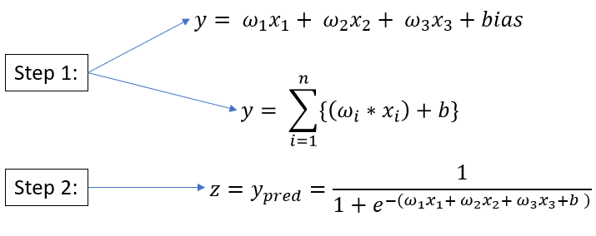

Slide 21
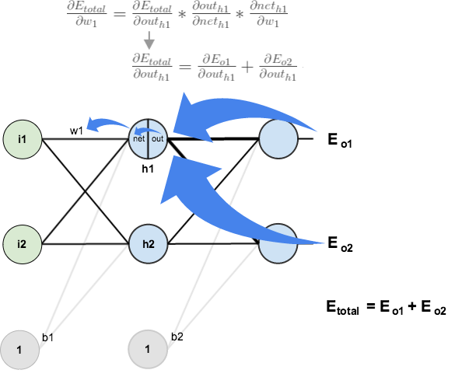
Backpropagation Algorithm
What we want to do is minimize the cost function J(θ) using the optimal set of values for θ (weights). Backpropagation is a method we use in order to compute the partial derivative of J(θ).
This partial derivative value is then used in Gradient descent algorithm for calculating the θ values for the Neural Network that minimize the cost function J(θ)
Backpropagation is about determining how changing the weights impact the overall cost in the neural network.

Slide 22
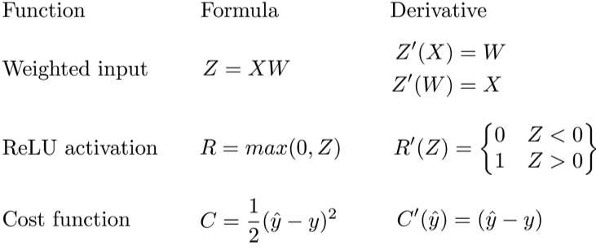
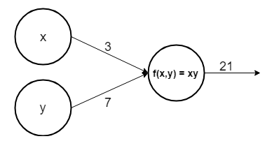
Why derivatives ?
The derivative of a function (in our case J(θ)) on each variable (in our case weight θ) tells us the sensitivity of the function with respect to that variable or how changing the variable impacts the function value.
Let’s look at a simple example neural network

Slide 23
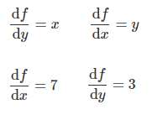
There are two input nodes x and y. The output function is calculating the product x and y. We can now compute the partial derivatives for both nodes
The partial derivative with respect to x is saying that if x value increase for some value ϵ then it would increase the function (product xy) by 7ϵ and the partial derivative with respect to y is saying that if y value increase for some value ϵ then it would increase the function by 3ϵ.

Slide 24
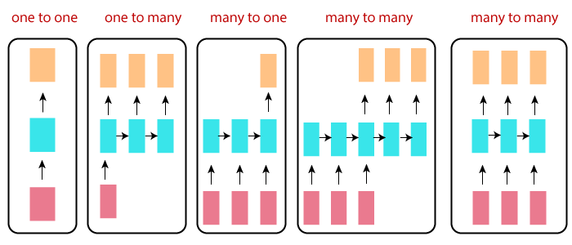
Types of RNN

Slide 25
When to Use Recurrent Neural Networks?
A recurrent neural network is a type of artificial neural network commonly used in speech recognition and natural language processing.
Recurrent neural networks recognize data's sequential characteristics and use patterns to predict the next likely scenario.

Slide 26
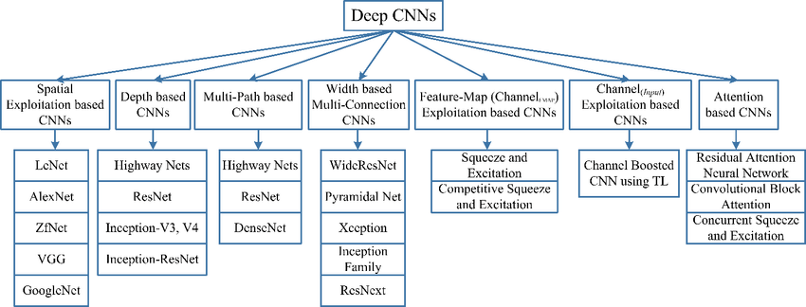
Types of CNN

Slide 27
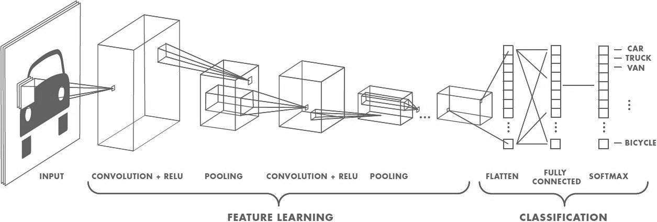
When to Use CNNs?
Convolutional Neural Networks (CNNs) are designed to map image data (or 2D multi-dimensional data) to an output variable (1 dimensional data).
They have proven so effective that they are the ready to use method for any type of prediction problem involving image data as an input.

Slide 28
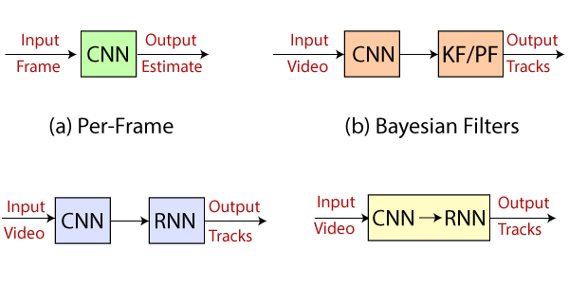
CNN and RNN Usage
A convolution neural network (CNN or ConvNet) is a network architecture for deep learning that learns directly from data.
CNNs are particularly useful for finding patterns in images to recognize objects, classes, and categories.
They can also be quite effective for classifying audio, time-series, and signal data.

Slide 29
Deep Learning Continued
Building logistic regression structured as Shallow neural network
Refer
More…

